Slide 1


Start Smart 1.0
^{5th} Grade
Lesson 11

Slide 2

ELD Objective
ELD Objective: Students will be able to engage in a Constructive Conversation using the Constructive Conversation Skill of NEGOTIATE, by taking turns, sharing ideas and making ideas clearer with a partner based on a visual text.

Slide 3
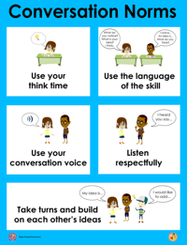
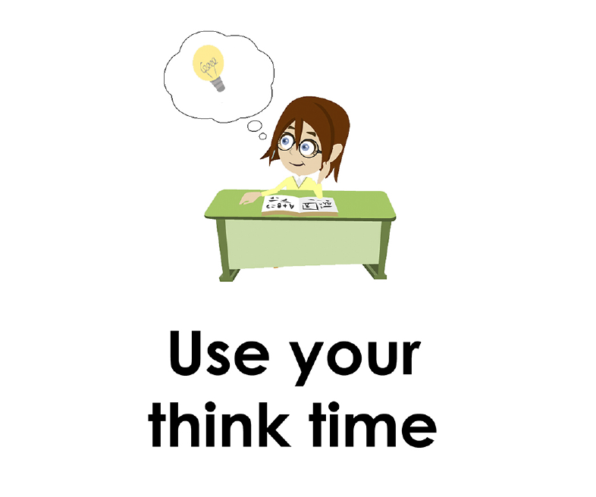
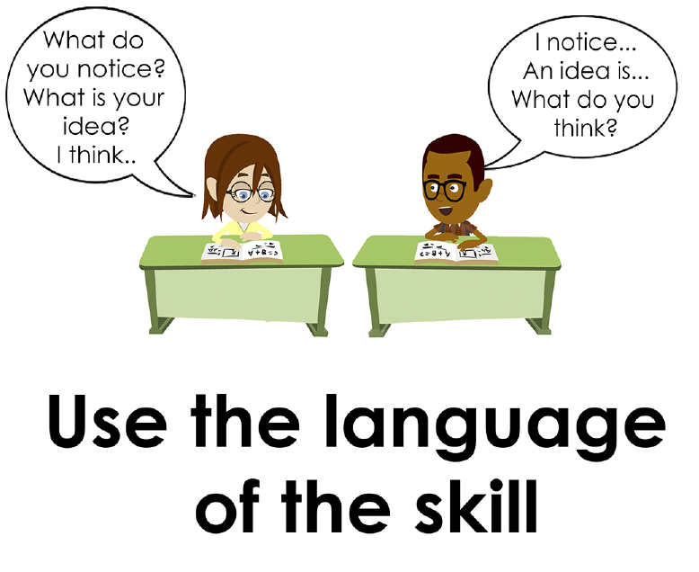
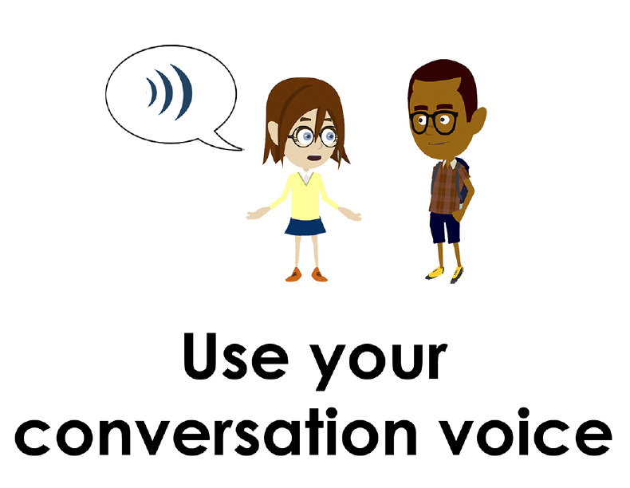
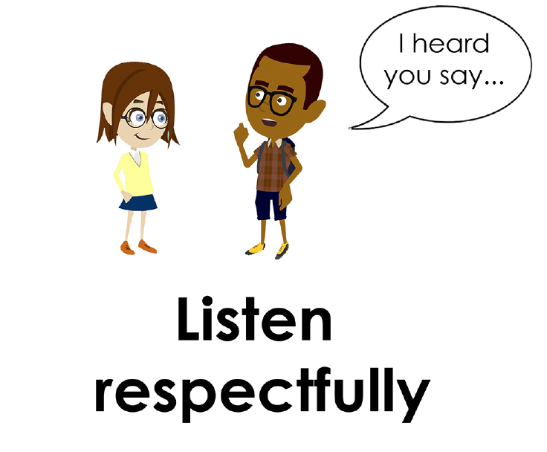
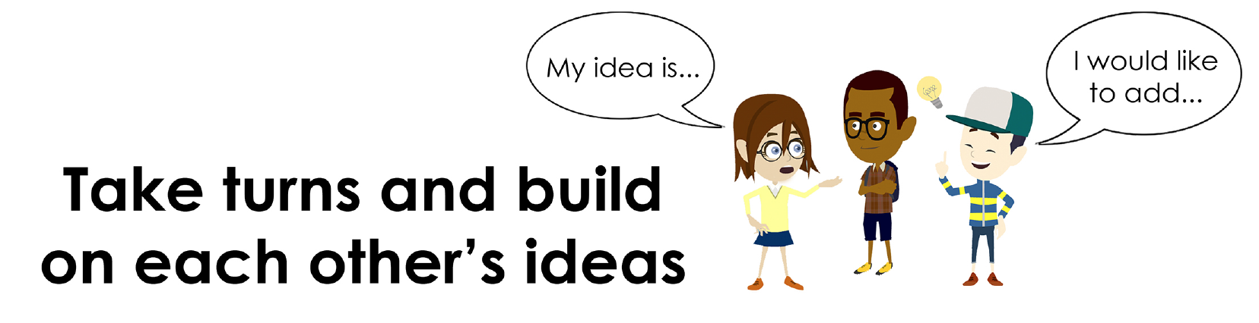
Conversation Norms Poster
  Use your think time
  Use the language of the skill
  Use your conversation voice
  Listen respectfully
  Take turns and build on each other’s ideas

Slide 4
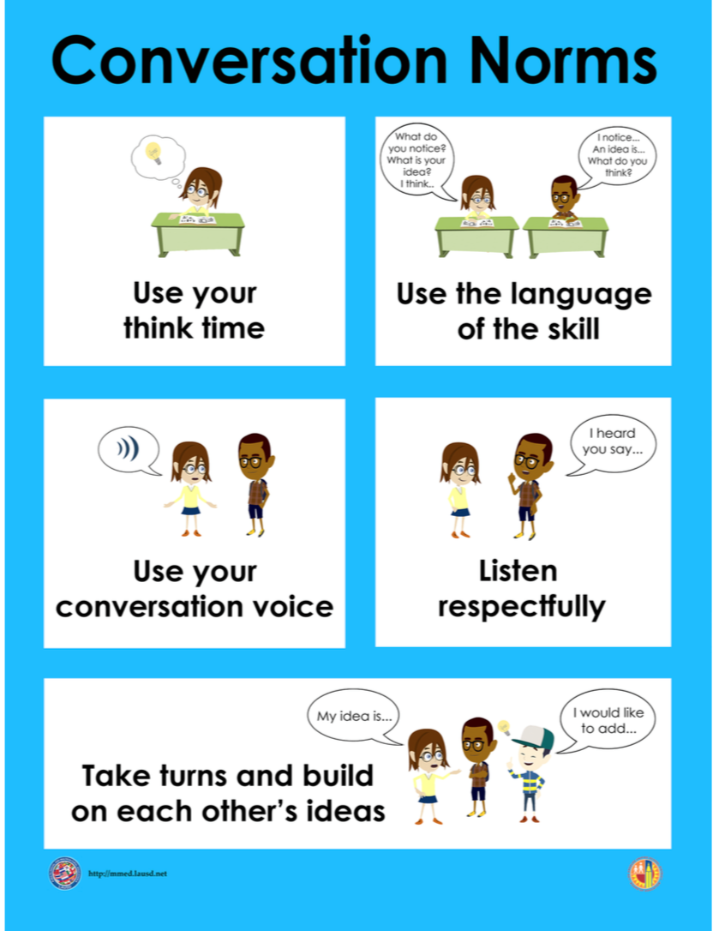
Notes:
The focus today is:
Use your think time
Use the language of the skill

Slide 5
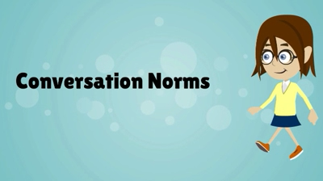
Conversation Norms
Notes:
Show Constructive Conversation Norms Video as a review of all norms

Slide 6
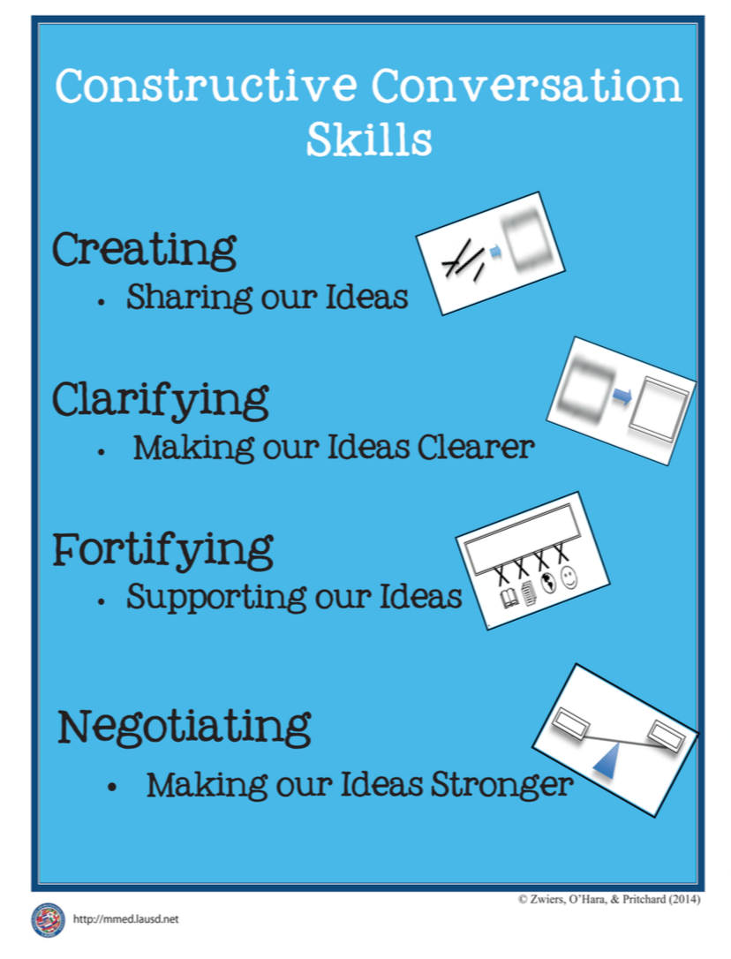
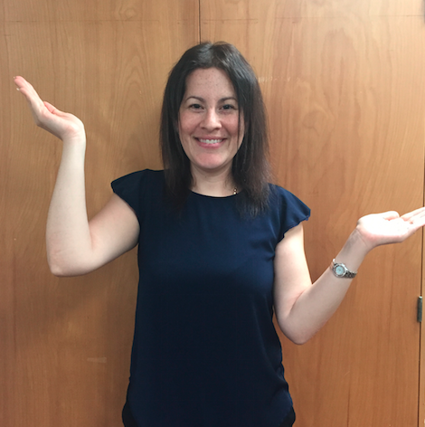
Hand Gesture and Phrase- NEGOTIATE
Making our Ideas Stronger
Notes:
Model NEGOTIATE and have participants repeat with you:
Place hand, palm down in front of you as if putting an idea on the table. Use four fingertips of the other hand to support the palm.

Slide 8
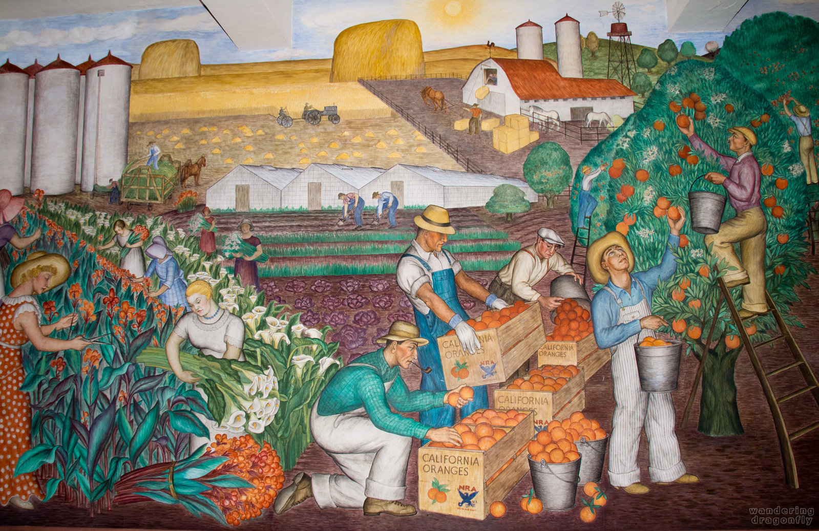
Prompt: What is an important idea from this text? Start by stating your claim. Support your claim and come to a consensus.
TEACHER VISUAL TEXT

Slide 9


Listen to the Model Constructive Conversation
  Use your think time to study the visual text.
Listen actively to what two partners say to each other.
Notes:
Provide a copy of the Model Script to the volunteer and allow time beforehand for student to review the script. Suggestions for reading the script:
● Show a video of students having the model conversation (optional)
● Student volunteer and teacher read model script
STUDENT LISTEN ACTIVELY

Slide 10
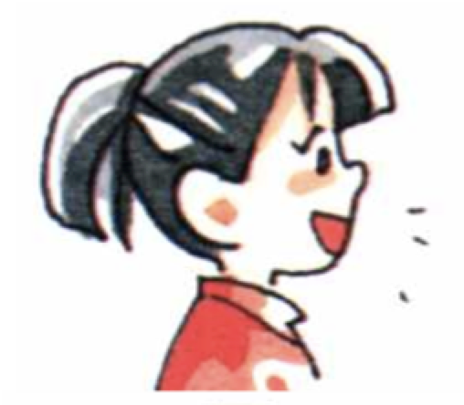
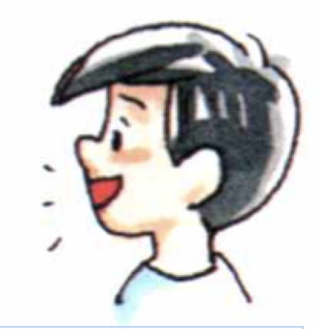
Visual Text Model
What is an important idea from this text? Start by stating your claim. Support your claim and come to a consensus.
Partner A: An important idea from this text is that agricultural work requires that people work with their hands.
Partner A: I think that the people picking fruit and gathering flowers are working with their hands. How can you support your claim with evidence?
Partner A:I think there are six people working with their hands harvesting flowers. There is just one women using scissors as a tool as she picks the flowers. The men work with their hands harvesting oranges by picking them by hand and putting them in the buckets and crates. How can you support your claim with evidence?
Partner A:I think an important idea from this text is that on a farm there is a variety of crops. To harvest them requires that agricultural workers use their hands or work with tools, animals or machines. Can we come to a consensus?
Partner B: An important idea from this text is that on a farm there is a variety of crops and they all require different work and skills.
Partner B:I think that the crops of flowers, oranges, and hay are harvested in different ways. The flowers and oranges are harvested by hand and using tools. The hay is harvested by agricultural workers that use horses, wagons and a tractor. How can you support your claim with evidence?
Partner B:I think to pick the fruit and flowers, the workers need the skill of careful collecting and carrying. To harvest hay, the workers need the skill of driving both for horses and tractors. Also, they need to be able to lift the heavy hay bales. How can we come to consensus?
Partner B:I think the important idea we came to a consensus on is that on a farm there is a variety of crops. To harvest them requires agricultural workers to use their hands or work with tools,
animals or machines using the skills they need for their job.

Slide 12
Listen to the Non-Model Constructive Conversation
  Use your think time to study the visual text.
Listen actively to what two partners say to each other.
Notes:
Provide a copy of the Non-­‐‑Model Script to the volunteer and allow time beforehand for student to review the script. Suggestions for reading the script:
● Show a video of students having the model conversation (optional)
● Student volunteer and teacher read model script
STUDENT LISTEN ACTIVELY

Slide 13
Visual Text Non- Model
What is an important idea from this text? Start by stating your claim. Support your claim and come to a consensus.
Partner A: On a farm there is a variety of crops.
Partner A: The flowers and oranges are harvested by hand and using tools. The hay is harvested by workers using a tractor.
Partner A: To pick the fruit and flowers, the workers need the skill of careful collecting and carrying. The workers need the skill of driving.
Partner A: On a farm there is a variety of crops. Agricultural workers use their hands or work with tools. Can we come to a consensus?
Partner B: Agricultural work requires that people work.
Partner B: People are picking fruit and gathering flowers are working with their hands.
Partner B: There are six people working with their hands. The men work with their hands harvesting oranges by picking them.
Partner B: On a farm there is a variety of crops.

Slide 14
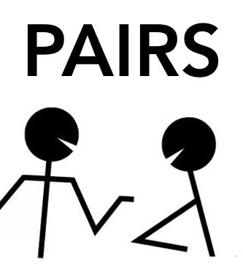
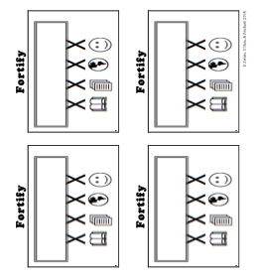
Constructive Conversation Game
PROMPT:
What is an important idea from this text? Start by stating your claim. Support your claim and come to a consensus.
Rules of the game:
Each of you needs 1 CREATE, 1 CLARIFY, 1 FORTIFY, and 2 NEGOTIATE cards
Each of you will play one card as you share an idea. You will continue taking turns until all cards are placed in the middle.
If you’re done early repeat the process for an additional round.
Remember to use the Constructive Conversation Norms and Skills as you play the game.
Notes:
You are now going to have the opportunity to practice the Constructive Conversation Skill NEGOTIATE while playing a game.
Explain the rules of the Constructive Conversation Game to students.

Slide 15
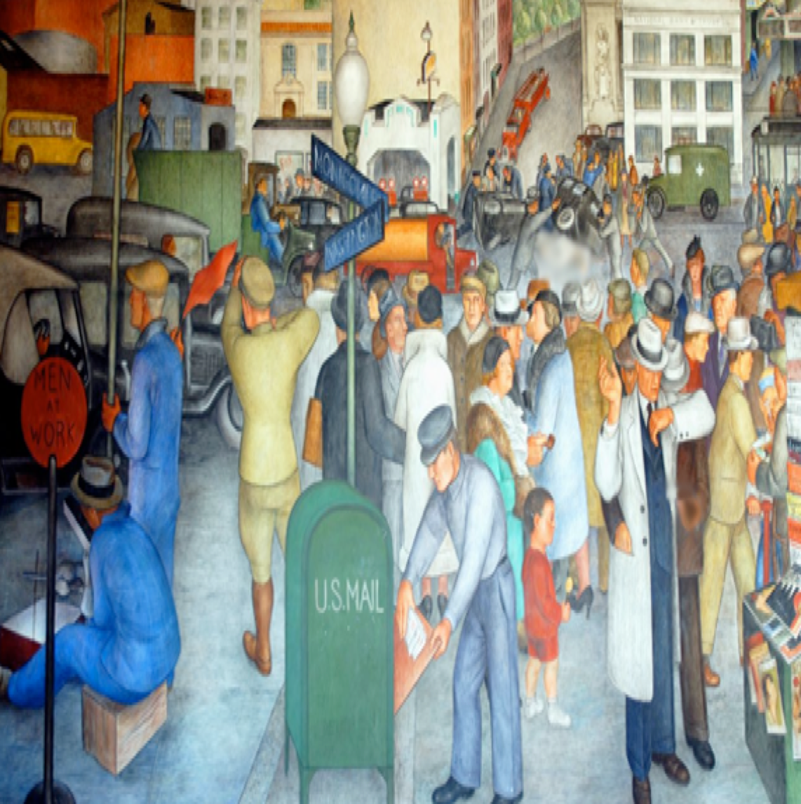

Prompt: What is an important idea from this text? Start by stating your claim. Support your claim and come to a consensus.
TEACHER COLLECTS LANGUAGE SAMPLE SPF 1.0
STUDENT VISUAL TEXT
Notes:
Display the Student Visual Text
Direct students to use their Think Time
As the students play the game, the teacher listens and selects two students who will replay the game in front of the class to serve as models.
This is an opportunity to capture a language sample.

Slide 16


CONSTRUCTIVE CONVERSATION
FISHBOWL MODEL
PROMPT: What is an important idea from this text? Start by stating your claim. Support your claim and come to a consensus.
Listen actively to what two partners say to each other.
FORMATIVE ASSESSMENT– TEACHER COLLECTS LANGUAGE SAMPLE SPF 1.0
Notes:
The two selected students will replay the game in front of the class and serve as models.
Student Progress Form (SPF)-­‐‑ Constructive Conversation Language Sample The teacher will collect a language sample from the two students on the Student Progress Form (SPF)-­‐‑ Constructive Conversation Language Sample to be used in Lesson 2. The language sample must be at least four turns in length. (Each turn includes both Partner A and B sharing

Slide 17
WRAP-UP
How did we meet today’s objective of using the Constructive Conversation Skill of NEGOTIATE?
How did you:
    Use your think time?
    Use the language of the skill
  Work with your conversation partner to do the following:
    Identify three things that you did to meet today’s objective
    Share and explain the three things to your partner
Notes:
Teacher will review ELD objective.
Today we engaged in a Constructive Conversation using the Constructive Conversation Skill-­‐‑NEGOTIATE. We took turns and shared ideas based on a visual text.
Teacher will ask students the following:
● How did we meet today’s objective of using the Constructive Conversation Skill of NEGOTIATE?
● How did you:
-Use your think time
-Use the language of the skill
● Work with your conversation partner to do the following:
Identify three things that you did to meet today’s objective
Share and explain the three things to your partner
Teacher calls on three students and they tell the class what was done today.

Slide 18
Start Smart 1.0
NEGOTIATE
^{5th} Grade
Lesson 12

Slide 19
ELD Objective
Students will be able to revise a Non-Model Conversation for the Constructive Conversation Skill- NEGOTIATE in a whole group setting and with a triad.
Notes:
Today we are going to review the Constructive Conversation Skill-­‐‑NEGOTIATE. When we create, we say what we notice about something.

Slide 20
Notes:
Let’s review the Conversation Norms Poster
Today, we will focus on:
Use the language of the skill
Use your conversation voice
**Give examples for both. Ask for student volunteers to model the two norms.

Slide 21
Conversation Norms
Notes:
Show Constructive Conversation Norms Video as a review of all norms

Slide 22
Hand Gesture and Phrase- NEGOTIATE
Making our Ideas Stronger
Notes:
Model NEGOTIATE and have participants repeat with you:
Place hand, palm down in front of you as if putting an idea on the table. Use four fingertips of the other hand to support the palm.

Slide 23
Prompt and Response Starters
Prompt Starters:
What is your claim…?
What is an important idea…?
Do you agree? Why?
Do you disagree? Why?
Response Starters:
My claim is…
An important idea is…
I agree because…
I disagree because…
Notes:
To model what a Constructive Conversation looks like we are going to use the visual text and the Listening Task Poster to address the following prompt: What is an important idea from this text? Start by stating your claim. Support your claim and come to a consensus. As we look at the visual text, we will NEGOTIATE, share our own ideas and come to a consensus.
Today I am going to model using the Constructive Conversation Skill of NEGOTIATE using these prompt and response starters. They will help us to communicate our ideas clearly. Have students round robin or chorally read previously charted prompt and response starters:

Slide 24
Notes:
Teacher will use questions and the Listening Task Poster to guide students through an analysis of what makes this a Model Constructive Conversation for the skill of NEGOTIATE.

Slide 25
Prompt: What is an important idea from this text? Start by stating your claim. Support your claim and come to a consensus.
TEACHER VISUAL TEXT
Notes:
Display the Student Visual Text
Direct students to use their Think Time

Slide 26
Listen to the Model Constructive Conversation
  Use your think time to study the visual text.
Listen actively to what two partners say to each other.
Notes:
Provide a copy of the Model Script to the volunteer and allow time beforehand for student to review the script. Suggestions for reading the script:
The audio will play automatically, or
● Show a video of students having the model conversation (optional)
● Student volunteer and teacher read model script
STUDENT LISTEN ACTIVELY

Slide 27
What makes this a model conversation?
Partner A: An important idea from this text is that agricultural work requires that people work with their hands.
Partner A: I think that the people picking fruit and gathering flowers are working with their hands. How can you support your claim with evidence?
Partner A:I think there are six people working with their hands harvesting flowers. There is just one women using scissors as a tool as she picks the flowers. The men work with their hands harvesting oranges by picking them by hand and putting them in the buckets and crates. How can you support your claim with evidence?
Partner A:I think an important idea from this text is that on a farm there is a variety of crops. To harvest them requires that agricultural workers use their hands or work with tools, animals or machines. Can we come to a consensus?
Partner B: An important idea from this text is that on a farm there is a variety of crops and they all require different work and skills.
Partner B:I think that the crops of flowers, oranges, and hay are harvested in different ways. The flowers and oranges are harvested by hand and using tools. The hay is harvested by agricultural workers that use horses, wagons and a tractor. How can you support your claim with evidence?
Partner B:I think to pick the fruit and flowers, the workers need the skill of careful collecting and carrying. To harvest hay, the workers need the skill of driving both for horses and tractors. Also, they need to be able to lift the heavy hay bales. How can we come to consensus?
Partner B:I think the important idea we came to a consensus on is that on a farm there is a variety of crops. To harvest them requires agricultural workers to use their hands or work with tools,
animals or machines using the skills they need for their job.
Notes:
Teacher will use questions and the Listening Task Poster to guide students through an analysis of what makes this a Model Constructive Conversation for the skill of NEGOTIATE.

Slide 28
Understanding the Skill of NEGOTIATE
Partner A: An important idea from this text is that agricultural work requires that people work with their hands.
Partner A: I think that the people picking fruit and gathering flowers are working with their hands. How can you support your claim with evidence?
Partner A: I think there are six people working with their hands harvesting flowers. There is just one women using scissors as a tool as she picks the flowers. The men work with their hands harvesting oranges by picking them by hand and putting them in the buckets and crates. How can you support your claim with evidence?
Partner A: I think an important idea from this text is that on a farm there is a variety of crops. To harvest them requires that agricultural workers use their hands or work with tools, animals or machines. Can we come to a consensus?
Partner B: An important idea from this text is that on a farm there is a variety of crops and they all require different work and skills.
Partner B:I think that the crops of flowers, oranges, and hay are harvested in different ways. The flowers and oranges are harvested by hand and using tools. The hay is harvested by agricultural workers that use horses, wagons and a tractor. How can you support your claim with evidence?
Partner B: I think to pick the fruit and flowers, the workers need the skill of careful collecting and carrying. To harvest hay, the workers need the skill of driving both for horses and tractors. Also, they need to be able to lift the heavy hay bales. How can we come to consensus?
Partner B: I think the important idea we came to a consensus on is that on a farm there is a variety of crops. To harvest them requires agricultural workers to use their hands or work with tools,
animals or machines using the skills they need for their job.
Notes:
Review Model
Remind students that we used this visual text before in a FORTIFY conversation. Say: Use ideas from that conversation to support your claim. Teacher introduces Model and asks for a previously selected volunteer to be their partner. Teacher and student read Model Script. Model using think time before speaking. Teacher will also discuss how the following norms were used during the conversation:
use the language of the skill
use your conversation voice
Note: Provide a copy of the Model Script to the volunteer and allow time before hand for student to review the script. Suggestions for reading the script:
Show a video of students having the model conversation (optional)
Student volunteer and teacher read model script
Prompt: What is an important idea from this text? Start by stating your claim. Support your claim and come to a consensus.
Model:
Student A:
An important idea from this text is that agricultural work requires that people work with their hands.
CR
Student B:
An important idea from this text is that on a farm there is a variety of crops and they all require different work and skills.
CR
Student A:
I think that the people picking fruit and gathering flowers are working with their hands. How can you support your claim with evidence?
CL
Student B:
I think that the crops of flowers, oranges, and hay are harvested in different ways. The flowers and oranges are harvested by hand and using tools. The hay is harvested by agricultural workers that use horses, wagons and a tractor. How can you support your claim with evidence?
CL
Student A:
I think there are six people working with their hands harvesting flowers. There is just one women using scissors as a tool as she picks the flowers. The men work with their hands harvesting oranges by picking them by hand and putting them in the buckets and crates. How can you support your claim with evidence?
F
Student B:
I think to pick the fruit and flowers, the workers need the skill of careful collecting and carrying. To harvest hay, the workers need the skill of driving both for horses and tractors. Also, they need to be able to lift the heavy hay bales. How can we come to consensus?
F N
Student A:
I think an important idea from this text is that on a farm there is a variety of crops. To harvest them requires that agricultural workers use their hands or work with tools, animals or machines. Can we come to a consensus?
N
Student B:
I think the important idea we came to a consensus on is that on a farm there is a variety of crops. To harvest them requires agricultural workers to use their hands or work with tools, animals or machines using the skills they need for their job.
N
Teacher will use questions and the Listening Task Poster to guide students through an analysis of what makes this a Model Constructive Conversation for the skill of NEGOTIATE.
Understanding the Skill: Negotiate
Teacher displays or distributes the Model Script from Lesson 11.
Example of Think-Aloud:
Student B:
I think to pick the fruit and flowers, the workers need the skill of careful collecting and carrying. To harvest hay, the workers need the skill of driving both for horses and tractors. Also, they need to be able to lift the heavy hay bales. F How can we come to consensus? N
Student A:
I think an important idea from this text is that on a farm there is a variety of crops. To harvest them requires that agricultural workers use their hands or work with tools, animals or machines. Can we come to a consensus? N
Student B:
I think the important idea we came to a consensus on is that on a farm there is a variety of crops. N To harvest them requires agricultural workers to use their hands or work with tools, animals or machines using the skills they need for their job.
Let’s look at the Model Script to find evidence of the skills of NEGOTIATE, FORTIFY, CREATE, and CLARIFY. How are we using the visual text to guide our conversation?
Let’s look at the last turns. Read them to yourself as I read them aloud (see example above).
Let’s look at the language of the skill. Look at Student A’s response. How do I know Student A used the skill of NEGOTIATE? I see the language of the skill (underline as noted above). I know this is NEGOTIATE because it is stating a claim so I will label it with N (Write N next to the response.) I also notice that Student B is using the language of the skill to state their claim, so I will label it with N (Write N next to the response and underline as noted above). Also, they use the language of NEGOTIATE to come to a consensus. (Write N next to the response). Then Students A and B come to an agreement by using the language of the skill (Write N to that turn).
Teacher prompts students to go throughout the same process with the rest of the Model Conversation.

Slide 30
Listen to the Non-Model Constructive Conversation
  Use your think time to study the visual text.
Listen actively to what two partners say to each other.
Notes:
Provide a copy of the Non-Model Script to the volunteer and allow time beforehand for student to review the script. Suggestions for reading the script:
● Show a video of students having the model conversation (optional)
● Student volunteer and teacher read model script
STUDENT LISTEN ACTIVELY
STUDENTS SHOULD LISTEN ACTIVELY

Slide 31
REVIEW Non- Model
What is an important idea from this text? Start by stating your claim. Support your claim and come to a consensus.
Partner A: On a farm there is a variety of crops.
Partner A: The flowers and oranges are harvested by hand and using tools. The hay is harvested by workers using a tractor.
Partner A: To pick the fruit and flowers, the workers need the skill of careful collecting and carrying. The workers need the skill of driving.
Partner A: On a farm there is a variety of crops. Agricultural workers use their hands or work with tools. Can we come to a consensus?
Partner B: Agricultural work requires that people work.
Partner B: People are picking fruit and gathering flowers are working with their hands.
Partner B: There are six people working with their hands. The men work with their hands harvesting oranges by picking them.
Partner B: On a farm there is a variety of crops.
Notes:
Review Non-Model
Teacher displays or distributes the Non-Model Script from Lesson 11.
Let’s look at the Non-Model Script. How can we improve this Constructive Conversation? This was our prompt, “What is an important idea from this text? Start by stating your claim. Support your ideas and come to a consensus. ” Here’s the visual text. Read it to yourself as I read it aloud. Think about the prompt and the language of the Constructive Conversation Skill NEGOTIATE.
Teacher will use questions and the Listening Task Poster to guide students through an analysis of what makes this a Non-Model Constructive Conversation for the skill of NEGOTIATE. See possible responses below.
No, they did not take turns sharing their ideas because partner A spoke two times in a row, without letting partner B take a turn
At first, they responded to the prompt, but towards the end they went off topic
They did not build on each other’s ideas
Teacher along with students will revise the text on chart paper or document reader.
Prompt: What is an important idea from this text? Start by stating your claim. Support your claim and come to a consensus.
Non-Model:
Student A:
On a farm there is a variety of crops. (Student does not start by making a claim; not prompting other partner)
Student B:
Agricultural work requires that people work. (Student does not start by making a claim; not prompting other partner)
Student A:
The flowers and oranges are harvested by hand and using tools. The hay is harvested by workers using a tractor. (not using language of the skill; not using evidence from the text to support the claim; not prompting other partner)
Student B:
People are picking fruit and gathering flowers are working with their hands. (not using language of the skill; not using evidence from the text to support the claim)
Student A:
To pick the fruit and flowers, the workers need the skill of careful collecting and carrying. The workers need the skill of driving.
Student B:
There are six people working with their hands. The men work with their hands harvesting oranges by picking them. (Student does not prompt for evidence)
Student A:
On a farm there is a variety of crops. Agricultural workers use their hands or work with tools. Can we come to a consensus?
Student B:
On a farm there is a variety of crops. (Student not reaching consensus)

Slide 32
REVISE
NON-MODEL
Note to Teacher: Consult pg. 55-56 of Start Smart 1.0 Lessons or Teacher Resources at end of
Power point
WHOLE-GROUP/CLASS REVISED NON-MODEL
Notes:
Teacher along with students revise the text on chart paper or document reader.
Revised* Non-Model:
*text indicates what the teacher should cross out as the text is being revised.
Bold indicates language revised.
Student A:
An important idea from this text is that on a farm there is a variety of crops and they all require different work and skills.
Student B:
An important idea from this text is that agricultural work requires that people work with their hands.
Student A:
I think that the flowers and oranges are harvested by hand and using tools. The hay is harvested by workers using a tractor. How can you support your claim with evidence?
Student B:
I think that the people picking fruit and gathering flowers are working with their hands. How can you support your claim with evidence?
Student A:
I think that to pick the fruit and flowers, the workers need the skill of careful collecting and carrying. To harvest hay, the workers need the skill of driving both for horses and tractors. How can you support your claim with evidence?
Student B:
I think there are six people working with their hands harvesting flowers. The men work with their hands harvesting oranges by picking them by hand. How can we come to consensus?
Student A:
I think the important idea from this text on is that on a farm there is a variety of crops. To harvest them requires agricultural workers to use their hands or work with tools. Can we come to a consensus?
Student B:
I think an important idea we came to a consensus on is that on a farm there is a variety of crops. To harvest them requires that agricultural workers use their hands or work with tools.
3. Refer to class revised Non-Model, have pairs read.

Slide 33
Prompt: What is an important idea from this text? Start by stating your claim. Support your claim and come to a consensus.
Notes:
Display the Student Visual Text
Direct students to use their Think Time

Slide 34

Language Sample Revision-Non-Model
You will work in a triad:
Number off from 1-3 to form a triad and select a student who will record the revision of the language sample
Read the language sample
Orally revise the language sample to improve the conversation
Use the prompt and response starters for NEGOTIATE
Be prepared to share out to the class
FORMATIVE ASSESSMENT– TEACHER COLLECTS LANGUAGE SAMPLE SPF 1.0
Notes:
Teacher will review ELD objective.
Today we revised a NEGOTIATE Non-­‐‑Model Constructive Conversation. We took turns and shared ideas based on a visual text.
Teacher asks students the following:
● How did we meet today’s objective of using the Constructive Conversation Skill of NEGOTIATE?
● How did you:
o use the language of the skill o use your conversation voice
● Work with your conversation partner to do the following:
o Identify three things that you did to meet today’s objective o Share and explain the three things to your partner
Teacher calls on three students and they tell the class what was done today.

Slide 35
WRAP-UP
How did we meet today’s objective of using the Constructive Conversation Skill of NEGOTIATE?
How did you:
    Use the language of the skill?
    Use your conversation voice?
Work with your conversation partner to do the following:
    Identify three things that you did to meet today’s objective
    Share and explain the three things to your partner

Slide 36
Start Smart 1.0
NEGOTIATE
5th GRADE
Lesson 13

Slide 37
ELD Objective
ELD Objective: Students will be able to engage in a Constructive Conversation using the Constructive Conversation Skill of NEGOTIATE, by sharing ideas and taking turns based on a visual text with a partner.
Notes:
Today we are going to practice the Constructive Conversation Skill FORTIFY. When we observe or read something new we have many thoughts and ideas. As we engage in a FORTIFY conversation, our job as speakers is to create and take ownership of our ideas. As listeners our role is to value and foster them same or different ideas we hear.

Slide 38
Notes:
Let’s chorally read the Conversation Norms Poster.
Use your think time
Use the language of the skill
Use your conversation voice
Listen respectfully
Take turns and build on each other’s ideas
Today, we will focus on:
Listen respectfully
Take turns and build on each other’s ideas

Slide 39
Conversation Norms
Notes:
Show Constructive Conversation Norms Video as a review of all norms

Slide 41
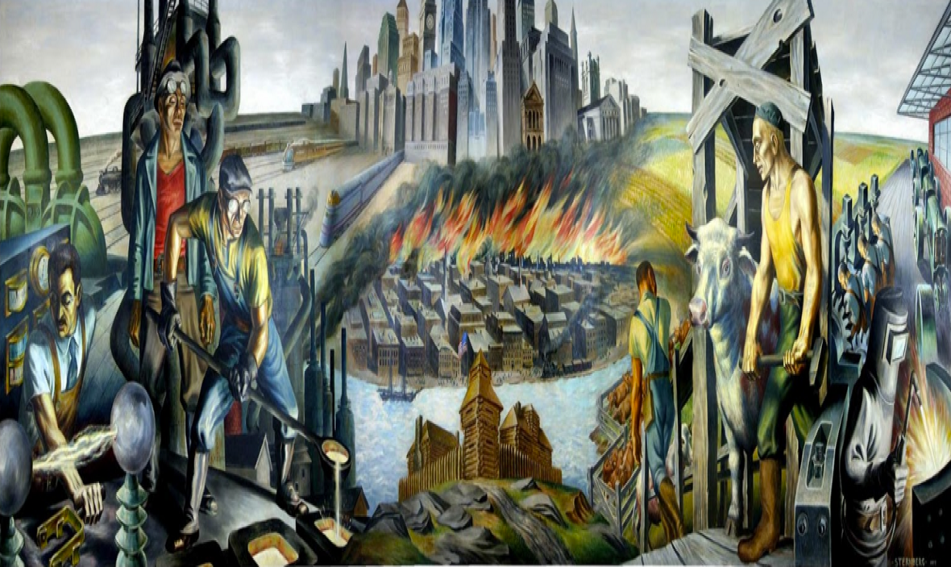
Prompt: What is an important idea from this text? Start by stating your claim. Support your claim and come to a consensus.
TEACHER VISUAL TEXT
Notes:
Display the Student Visual Text
Direct students to use their Think Time

Slide 42
Listen to the Model Constructive Conversation
  Use your think time to study the visual text.
Listen actively to what two partners say to each other.
Notes:
Provide a copy of the Model Script to the volunteer and allow time beforehand for student to review the script. Suggestions for reading the script:
● Show a video of students having the model conversation (optional)
● Model with a student using the Model Script.

Slide 43
Visual Text Model
What is an important idea from this text? Start by stating your claim. Support your claim and come to a consensus.
Partner A: An important idea is that the city changes as people’s tools and work change. What is your claim?
Partner A: I think the city develops and gets larger in the visual text as the workers use more complicated tools. How can you support your claim with evidence?
Partner A:I think that in the text, people’s work changes. For example, there is a man using a hammer to make cattle pens. Then people build tractors by welding and using machines. This work is done in
factories. So, the city needs to rebuild for factories. How can you support your claim with evidence?
Partner A: I think the city develops and becomes larger as people’s tools and machines become more complicated so worker’s jobs change. Can we come to a consensus?
Partner B: An important idea is that people’s work changes as their tools change. How can you support your ideas with evidence?
Partner B: I think that people have machines that do more work for them as their tools get more complicated. I notice that happening in the visual text. How can you support your claim with evidence?
Partner B: I think people’s work changes because they need to use their muscles less as they use machines more. For example, the two people smelting metal need to carry the heavy ladle, but the man making electricity just flips a switch. However, he needs to study manuals and books about electricity so that the current will flow. As the worker’s jobs change, they need to know new and different things. How can we come to a consensus?
Partner B:I think the important idea we came to a consensus on is that the city develops and becomes larger. When people’s jobs change because they get new and more complicated tools, they learn new things, and
use more complicated machines.

Slide 45
Listen to the Non-Model Constructive Conversation
  Use your think time to study the visual text.
Listen actively to what two partners say to each other.
Notes:
Provide a copy of the Non-Model Script to the volunteer and allow time beforehand for student to review the script. Suggestions for reading the script:
● Show a video of students having the model conversation (optional)
● Model with a student using the Non-Model Script.

Slide 46
Visual Text Non- Model
What is an important idea from this text? Start by stating your claim. Support your claim and come to a consensus.
Partner A: I notice the people in the street having fun. They are on a Halloween parade. What do you notice?
Partner A: I notice costumes and people wearing gowns, suits and some wearing regular clothes. What do you notice?
Partner A: I know people are in costume.
Partner A: I see that people are just standing around and I see balloons.
Partner B: What I see happening in the visual text is people from a town posing for a picture.
Partner B :People have hats and gowns. They look like they are going to a party and they are all standing waiting for the picture.
Partner B: When it’s Halloween I like to dress up.
Partner B: No turn taken

Slide 47
Constructive Conversation Game
PROMPT:
What is an important idea from this text? Start by stating your claim. Support your claim and come to a consensus.
Rules of the game:
Each of you needs 1 CREATE, 1 CLARIFY, 1 FORTIFY, and 2 NEGOTIATE cards
Each of you will play one card as you share an idea. You will continue taking turns until all cards are placed in the middle.
If you’re done early repeat the process for an additional round.
Remember to use the Constructive Conversation Norms and Skills as you play the game.
Notes:
You are now going to have the opportunity to practice the Constructive Conversation Skill NEGOTIATE while playing a game.
Explain the rules of the Constructive Conversation Game to students.

Slide 48
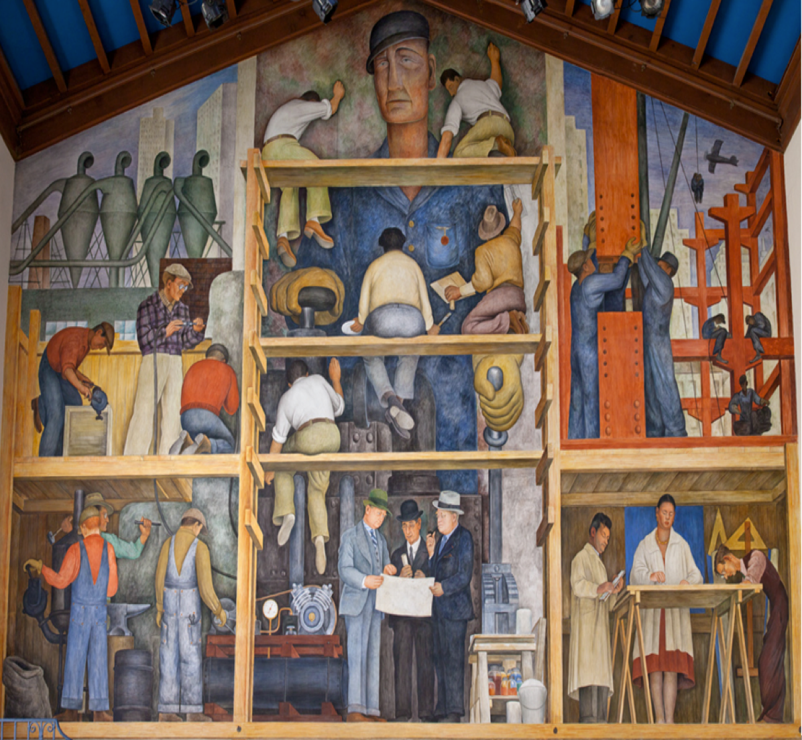
Prompt: What is an important idea from this text? Start by stating your claim. Support your claim and come to a consensus.
TEACHER COLLECTS LANGUAGE SAMPLE SPF 1.0
STUDENT VISUAL TEXT
Notes:
Display the Student Visual Text
Direct students to use their Think Time
As the students play the game, the teacher listens and selects two students who will replay the game in front of the class to serve as models.
This is an opportunity to capture a language sample.

Slide 49
CONSTRUCTIVE CONVERSATION
FISHBOWL MODEL
PROMPT: What is an important idea from this text? Start by stating your claim. Support your claim and come to a consensus.
Listen actively to what two partners say to each other.
FORMATIVE ASSESSMENT– TEACHER COLLECTS LANGUAGE SAMPLE SPF 1.0
Notes:
The two selected students will replay the game in front of the class and serve as models.
Student Progress Form (SPF)-­‐‑ Constructive Conversation Language Sample The teacher will collect a language sample from the two students on the Student Progress Form (SPF)-­‐‑ Constructive Conversation Language Sample to be used in Lesson 2. The language sample must be at least four turns in length. (Each turn includes both Partner A and B sharing

Slide 50
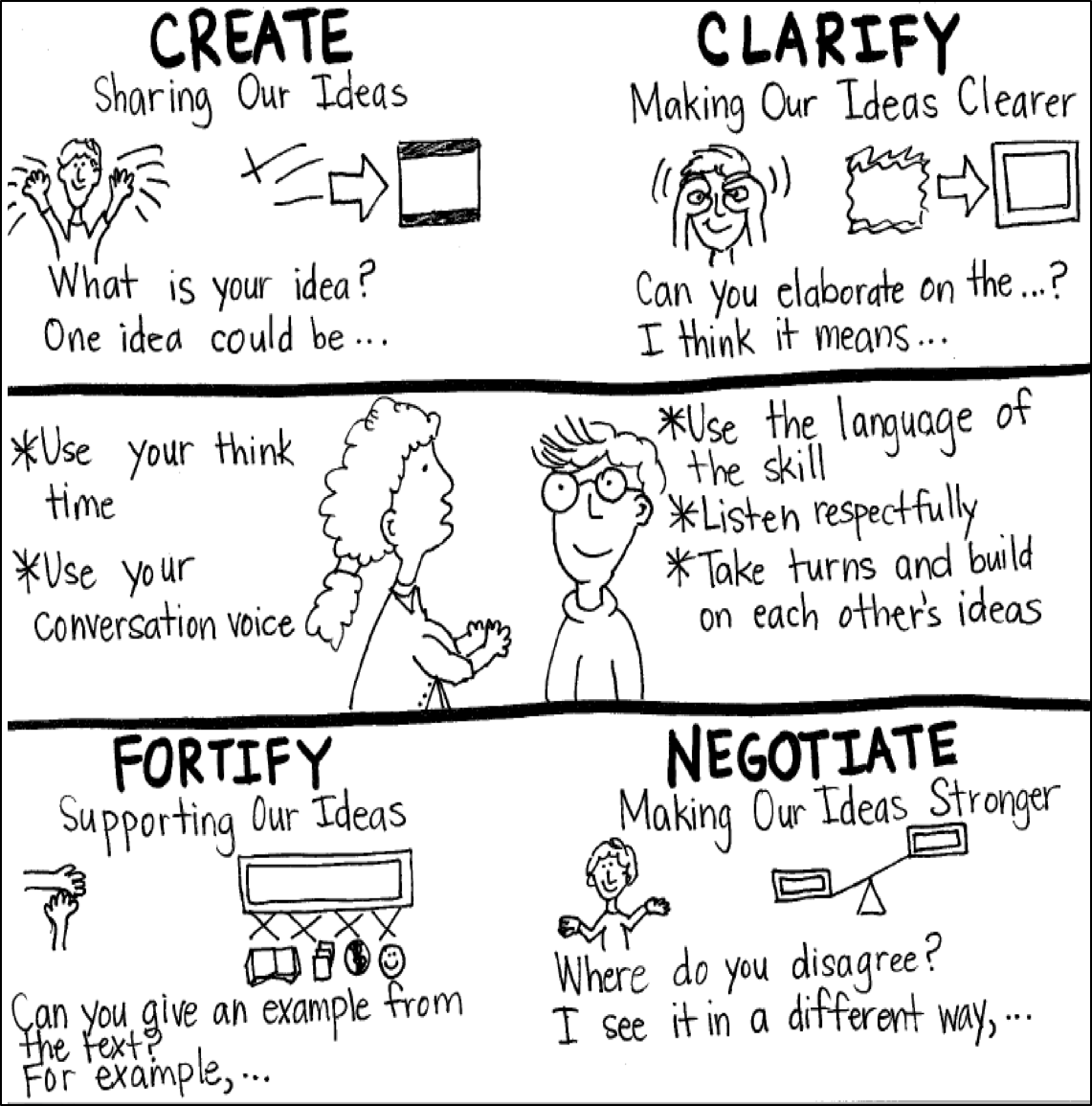
Model Creating Class Constructive Conversation Poster
Sample
Notes:
Teacher models creating a Constructive Conversation Poster. This slide is a resource. Teacher elicits student responses to help student develop a poster that illustrates their understanding of the NEGOTIATE skill and conversation norms.

Slide 51
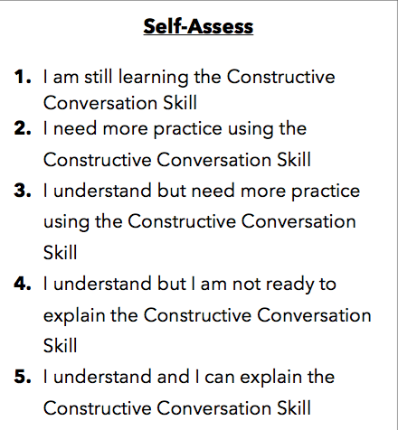
Notes:
Teacher will review the Constructive Conversation Skill NEGOTIATE
Students will self-assess answering the prompt
Teacher may select a conversation pair to share out.
EXAMPLE:
Student: I rated myself a 3 because…
Teacher: What can you do to move to a 4?

Slide 52
Teacher Resources

Slide 53
NEGOTIATE Non-Model Revision

